Slide 1
Objective for this project
Design a trackable, self-improving system for prediction of resale HDB prices, allowing Singaporeans to estimate how much savings they need to have.
Target of ML problem
Predict resale HDB flat prices based on: time passed since 2016, location, number of rooms, house size, floor range, flat model, remaining lease
Metrics (overestimate better than under?)
Experimental: MAE
Short term: MAE
Long term: MAE within a threshold? How to define?
Retraining threshold
Based on long term goal, to be defined
Frequency of prediction
Made on request, given a selected set of variables
Online evaluation: N/A
Frequency of retraining
Every week, offline batch
Offline evaluation: Batched, MAE
Data
Baseline data: until 12 Aug, around 4-5pm
New data: Data from 13 Aug onwards. Pull from data.gov API

Slide 2
Ingestion + Feature engineering
Package for data ingestion: Polars (with SQL code)
Scheduler for ingestion: AWS EventBridge Scheduler
Feature store: AWS S3
Feature engineering: AWS Lambda (Python) → To run this every X time unit
Data versioning: MLFlow
Orchestrate using AWS EventBridge,
Mainly to deal with new data, and if retraining of model is required
Modelling > Monitoring > CI/CD
Package for modelling: scikit-learn
Package for Model/experiment versioning: MLFlow
CI/CD tool: Github Actions
A/B Testing: TBC
App (just dropdowns/radial buttons) + Deployment
Deployment: Docker(Hub) + AWS ECS + AWS Fargate
API: FastAPI
Front-end: Streamlit
Scaling (KIV): AWS App Runner + AWS ECR

Slide 3
Catch up 12 Sep 2025
Agenda:
In general: having an engineering mindset
Vetting what I’ve done
CI/CD done correctly? Robust enough? Separate vs together? Data?
What to push to cloud? E.g. AWS Lambda functions for data cleaning, MLFlow server, hyperparameter search,
When to deploy to production/main?
Usage of logging
File structure
Looking forward: Prioritising what to do next e.g. modelling
Consulting vs other types of DS

Slide 4











Overview
Data + Model
App
Data processing
Model training & output champion model locally
1 task on ECS
Data scheduled pull
Notes:
Data processing: Split into 2012-2023, 2024 and 2025++ for train, test and deployment purposes
Note: All boxes are services

Slide 5
CI
Objective: Whenever want to update file on GitHub, to use a template for a sequence of events, which takes into account testing, and also reporting of the results of the push.
Makefile is the recipe, while the YAML file is the skeleton while pulls from the recipe + decides the environment variables which is fed into the recipe
Implemented for: Model prediction

Slide 6
Unit testing
Objective: Get the smallest possible unit of your code, and ensure that those units (e.g. functions, methods) work. Can proceed on to integration testing where the units interact with one another
Can be split into MLOps segments. Each segment have diff considerations
Data Engineering: hardcode an input to pass into this function and leverage Pytest/unittest to check for the exact output. Check handling of edge cases
??Model Training: check for successful predictions on training data to a degree of accuracy based on your evaluation metric
[D] Model Serving: Combination of the 2 above + ensure that frontend works

Slide 7
TODO
Pull ct to main. Just work on main from there
Automate both the CV and Final modelling on cloud (AWS Lambda, github actions, whatever). Try to merge with MLFlow if can, otherwise just do reporting separately. Importantly, give scores + important charts. Rmb to ensure S3 storing model has version tracking on
Send report to slack
How to test that docker images on docker hub works after CI/CD?
Ensure FastAPI app can read best model from S3:
https://devopscube.com/github-actions-oidc-aws/
Automate AWS Lambda updates (e.g. data cleaning) using AWS CLI/github actions so that don’t have to keep copy and pasting
Download new data filtered by date, process and then append to existing feature store
Code robustness: Work on unit testing → Data + others. Robust tests. Practice one unit test per PR. Think about when to use try-except statements (get chatgpt to suggest). Perform checks while script is running as well, on top of the unit tests

Slide 8
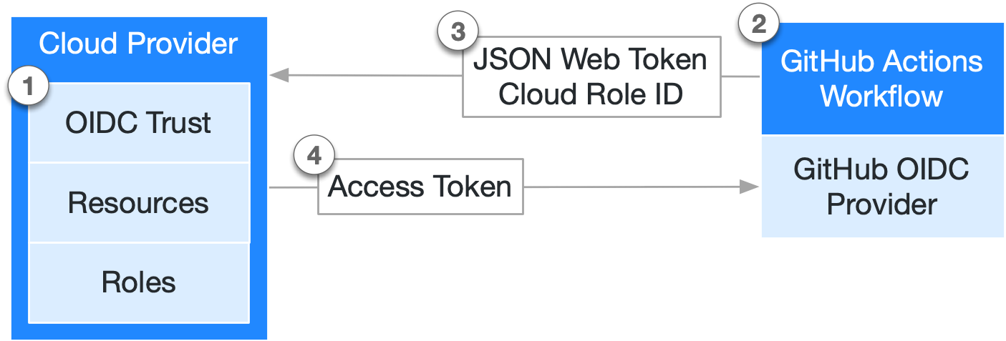
Github OIDC
Github action accesses service using the Github role assumed
With role given which already trusts OIDC in a federated way
AWS Service (needs to be able to assume role)

Slide 9
TODO - Extras
Zeng the reported metrics
Do hyperparameter tuning separately
See if can combine with MLFlow
Logging (if have time). Get chatGPT to suggest. Used with AWS cloudwatch, but watch the costs involved. http://logging.apache.org/log4j/1.2/manual.html

Slide 10
Architecture for training on cloud
Send results to Slack
Use Github actions to create MD file for results
Upload results to S3
Define parameters on script
Cross-validation on Github actions when pushing
Upload best model to S3
Best model pulled from S3 when dockerising app

Slide 11
CT
[D] Factorise modelling + MLFlow code, logging results to cloud (Can be prod or expt – Tags to differentiate)
Objective: Hyperparameter tuning
Retraining based on time/data ingestion @ X time unit
Objective: Let model capture new trends in data
Separate script which uses the same hyperparameters from experimentation (local), but does the comparison and retraining on AWS (Lambda?)
? Need to come up with the final model, trained on all data
Or is it still need a holdout set?
Train on 1~ T-1 week, test on T-1 week ~T (Is 1 week enough?)
Need to process data to output the delta for testing → Correspond to frequency of pulling data, which corresponds to how often the data is updated
Can implement A/B testing afterwards to check if there is indeed and improvement over the old model. Do not deploy if performance drops
Still necessary to compare 5 fold CV in addition to test set?
Pseudo-Canary testing?
Can find hard quality gates here: https://mlflow.org/docs/3.1.3/ml/evaluation/model-eval/
Find a way to push to production automatically, while involving MLFlow (have to do the tagging/aliasing automatically). Need to push the model to AWS ECS at the moment as well → needs more thinking!

Slide 12
CT (Extras)
Error analysis + Logging
BentoML for batched inference/serving

Slide 13
